Slide 1

Distro Energy
Data analysis & future predictions
Mpagi Kironde (PhDc, AI)
Lead machine learning engineer
Code: https://github.com/kirondem/solar-energy-prediction

Slide 2
Data Analysis
Solar production per month
Daily average production
Anomaly detection (Visual)
Findings
Feature engineering
Modelling
Results and evaluation
Further research and improvements
Generating more data

Slide 3
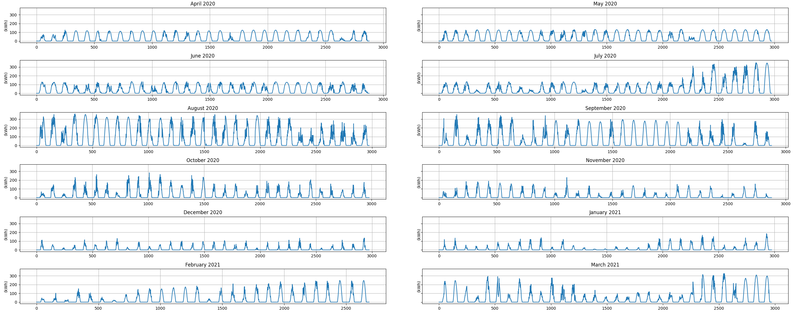
Data analysis
Solar production per month
Figure 1: Solar production datapoints (15min intervals) per month

Slide 4
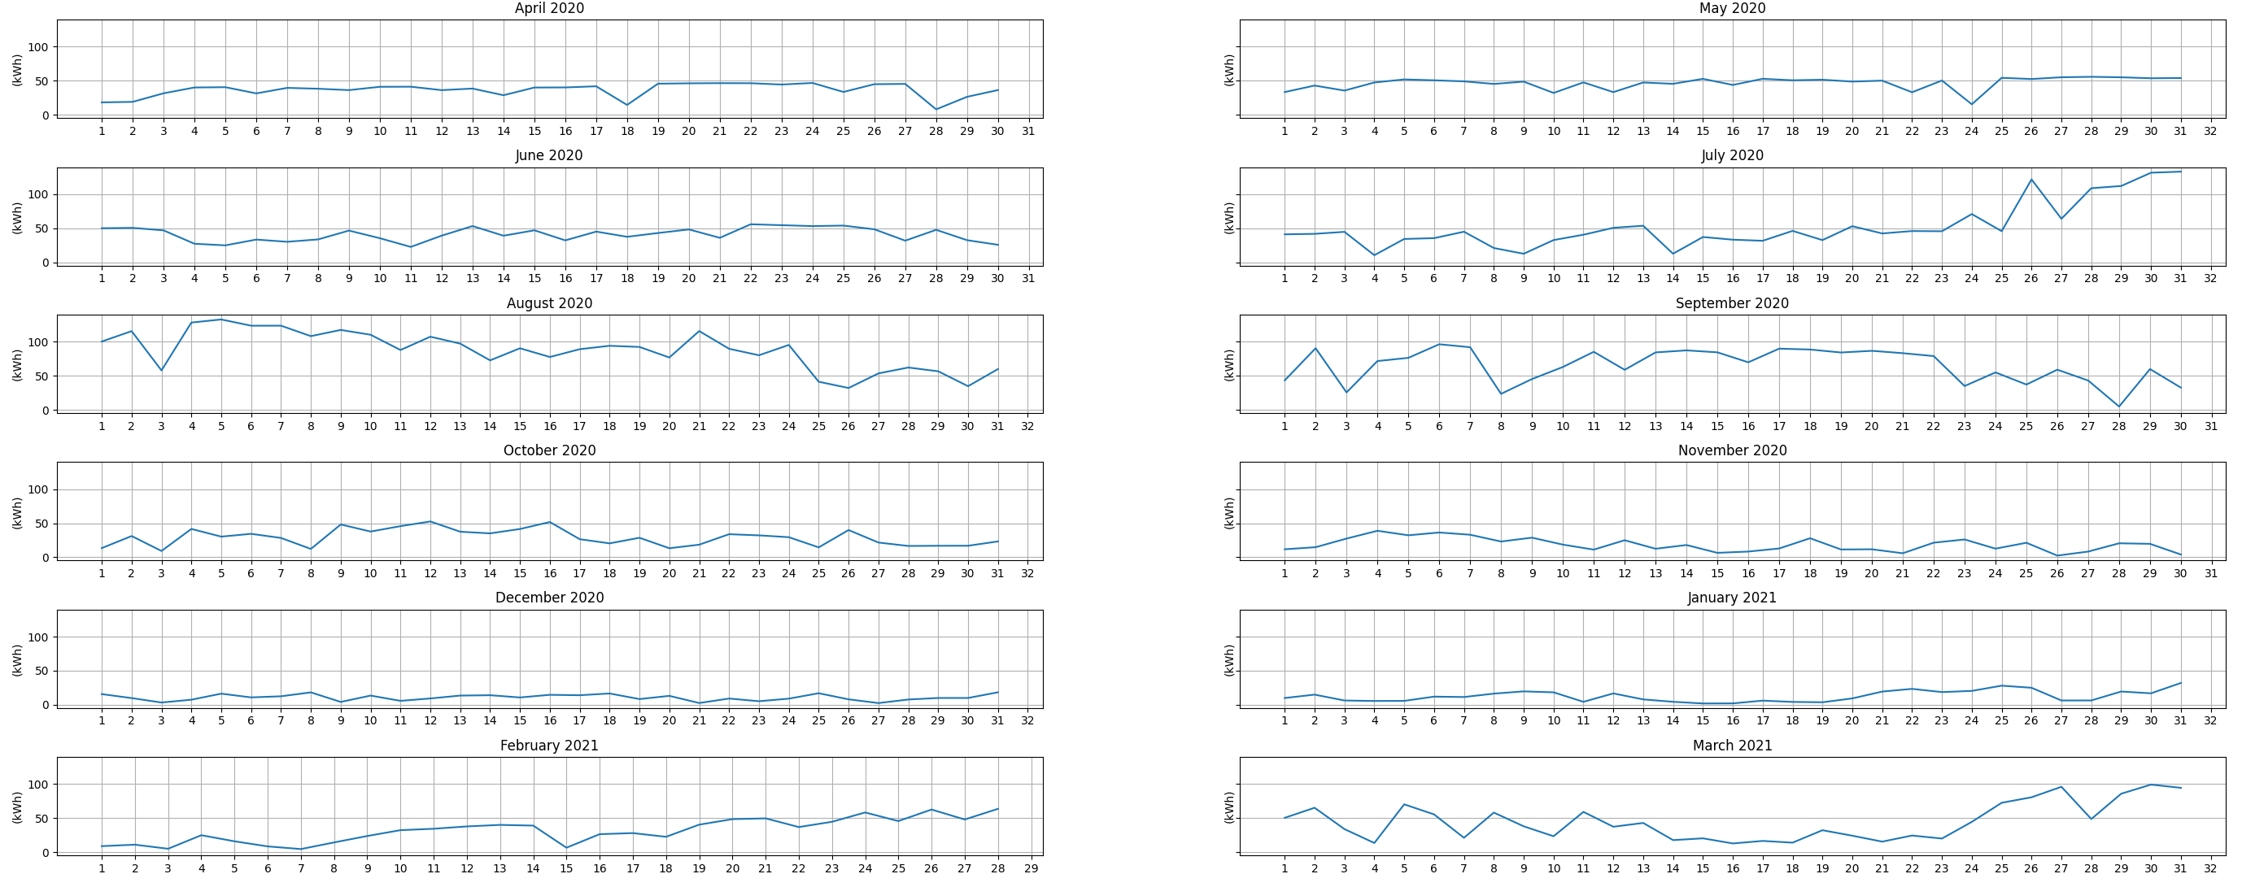
Daily average production
Figure 2: Daily average per month

Slide 5
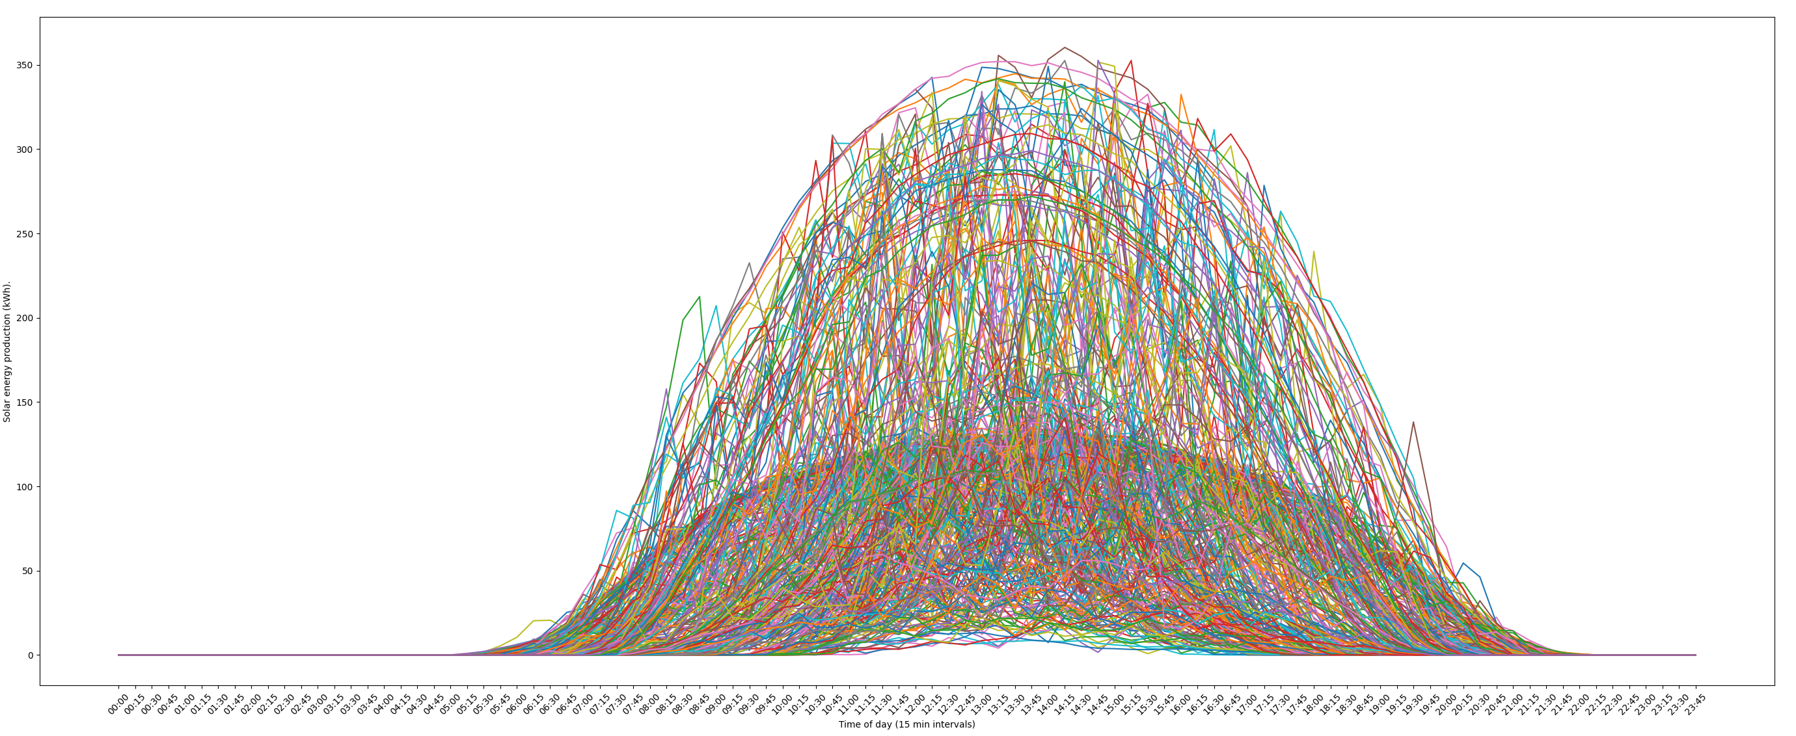
Anomaly detection (Visual)
Figure 3: Visual of all daily productions datapoints
I expected daily solar productions to have a gaussian (Bell) shape, with peak production during the day, this can be clearly seen (Figure 3) which plots all daily production for the year.
I expected zero production during nighttime (22:00 – 05:00), clearly shown in (Figure 3)
I expected only positive production totals, no negatives.

Slide 6
Findings
There seems to be shift in the data, readings from April/May 2020 (Figure 1) seem to be very uniform and smooth, suspect data was artificial generated
As expected, peak production is in summer months, capturing the seasonality of solar production. (Figure 2) daily average
Anomaly analysis: There was no anomaly in the data apart from what I suspect were duplicate datapoints, which is not a major issue when training DNN

Slide 7
Feature engineering
Categorical data
DateTime:
We can think of date and time as categorical inputs to Deep neural network (DNN). String labels should be one hot encoded.
The Year component is removed as we want our model to learn seasonal variations and generalise through time
Embeddings:
We then train our model to learn an embedding (Vector representation) of categorical data. Spatial representation, the idea is November should be closer in high dimensional space to December than July. This is the real power of DNN we do not need to hand engineer features.
Numerical value normalisation
Total value:
We need to normalise numerical values around mean zero to enable the DNN to converge faster.
Positional embeddings
The idea is to use fixed or learned weights which encode information related to a specific position of a datapoint in sequence
Data augmentation
Weather data would be an invaluable feature to add our dataset, i.e., amount of sunlight

Slide 8


Modelling
My model of choice is the state of art Deep Neural Network (DNN) model based on Transformer architecture by Google brain team (https://arxiv.org/pdf/1706.03762.pdf)
Why a transformer?
Transformers offer superior performance over traditional models such as RNN, LSTM
Transformers do not suffer from vanishing gradients (long dependency issues) meaning that they are able to learn longer trajectories
Faster to train as they offer parallelization, thus improving efficiency in computation
State of art deep learning architecture (Attention mechanism)
What is Attention mechanism?
Human memory can also be thought of as attention through time. Attention seems to have emerged as the latest new transformative component that has been added to the deep learning toolkit.
https://towardsdatascience.com/the-fall-of-rnn-lstm-2d1594c74ce0
https://www.arxiv-vanity.com/papers/1910.03771/
Model architecture and hyper parameters (Tunable)
Number of layers: 5
Input dimensions: 44
Training epoch: 20
Learning rate: 0.0001

Slide 9
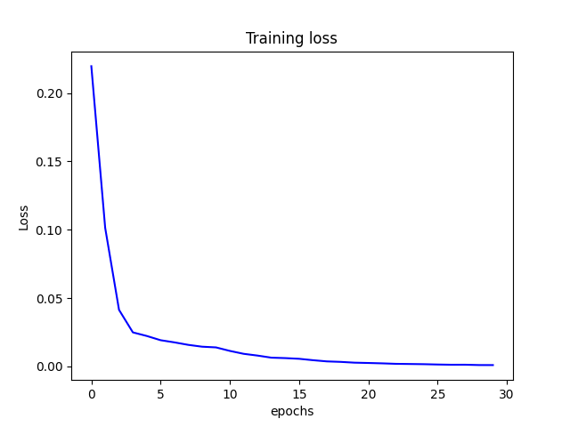
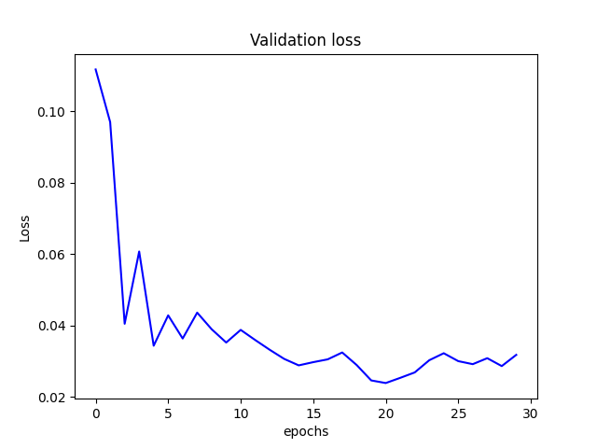
Training the model
Datasets
The dataset was split along seasonality dimension (spring, summer, autumn, winter), intuition is to have specialist models rather one general model. Explore splitting by month (Future work)
The season data was further split in training set (80%), validation set (10%), test set (10%)
The validation and test set are never exposed to the model during training but used to test the model's accuracy during and after training
Training features:
["day", "month", "hour", "minute"]
['sin_day', 'cos_day', 'sin_month', 'cos_month', 'sin_hour', 'cos_hour', 'sin_min', 'cos_min', 'Total']
Training model
The model was trained over 30 epochs, too many epochs and the model will likely overfit.
I used a clustered GPU environment to train the model, without a GPU training would take hours rather minutes.
Training loss criterion: MSE (Mean squared loss)
The model was able to learn and converge as shown by training loss curve.
The validation loss shows the model, improving its accuracy (minimizing loss) on unseen data with each epoch

Slide 10
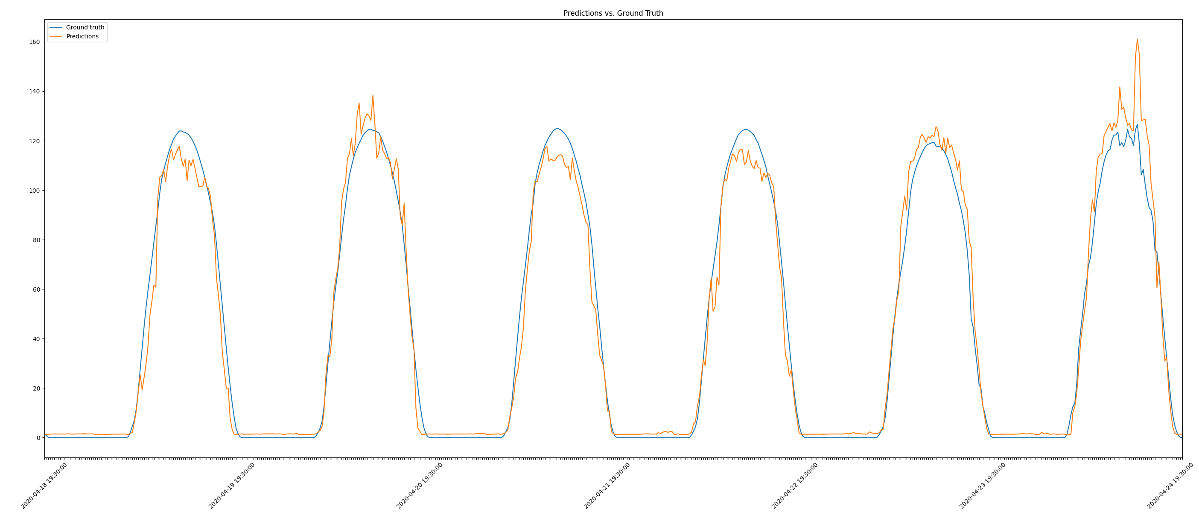
Results and evaluation
The Transformer model was able to learn the daily solar pattern fluctuation and zero production during the night.
The model’s accuracy does not deteriorate much as you expand the forecast horizon as it learnt the latent pattern in the data
Test results
Below are the prediction results of the model on unseen test data, datapoints between (2020-04-18 19:30:00 to 2020-04-24 21:30:00)
As shown in (Figure 4), the model does a great job learning the pattern in the data.
Model score an impressive RMSE: 7.8 kWh
Figure 4: Test data predictions

Slide 11
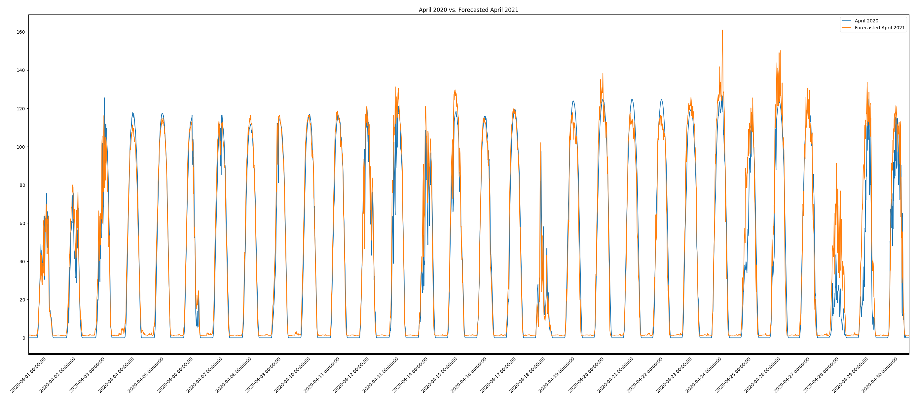
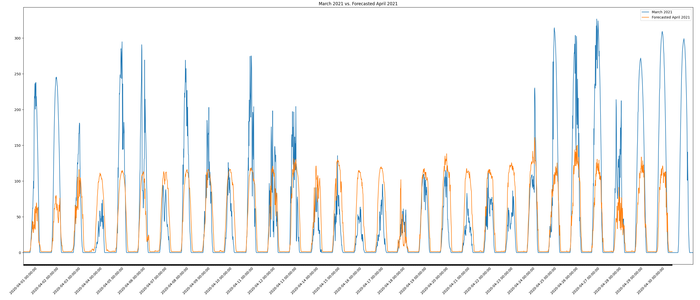
Results and evaluation
Forecast for period April 2021 (The data can be found in file data/predictions.csv)
Figure 5: Comparing April 2020 vs Forecasted April 2021
Figure 6: Comparing March 2021 vs Forecasted April 2021
Evaluation
The model learnt the daily pattern of the data, peaks during the day and zero production during the night
The model was able to predict April production very well, (Figure 5).
April 2020 seems to have been artificially generated (Figure 6), when you compare March 2021 with forecasted April 2021, the scale is way off, because March 2021 is ground truth data while model learnt from artificial data.

Slide 12
Further improvements and research
With more time, I would have liked to create a baseline model to compare the transformer with, i.e., LSTM, simpler statistical or machine learning models typically tried for time series regression.
Research increasing the size of model, bigger models have more capacity but take longer to train.
Model hyperparameter optimization to further improve the model's accuracy. (Learning rate, weight decay, no of head, hidden layer size, dropout, optimizer)
Fine tune training data sequence length
Do further analysis of data, i.e., correlations in the data
Explore split data by month and train specialist to learn patterns for each month
DNN perform better with more data, sourcing more data or even generating more synthetic data should be investigated.
Explore data augmentation, i.e., weather data

Slide 13
Generating more data
Below are two approaches that be explored to generate more, rather using simpler naïve approaches of a adding noise to the data
1. Transformers
After training the DNN model its now relatively easy to generate synthetic data. This would be a recursive iterative loop, where the model uses a previous prediction to make future prediction.
Data generation code has been provided. (generate_data.py)
2. Generative Adversarial Networks (GAN)
Generative modelling is an unsupervised learning task in machine learning that involves automatically discovering and learning the regularities or patterns in input data in such a way that the model can be used to generate or output new examples that plausibly could have been drawn from the original dataset.
Generative Adversarial Networks (GAN) are a clever way of training a generative model by framing the problem as a supervised learning problem with two sub-models (generator and discriminator model) i.e. Deep fakes

